Slide 1

Arena & Environment Look Book

Slide 2
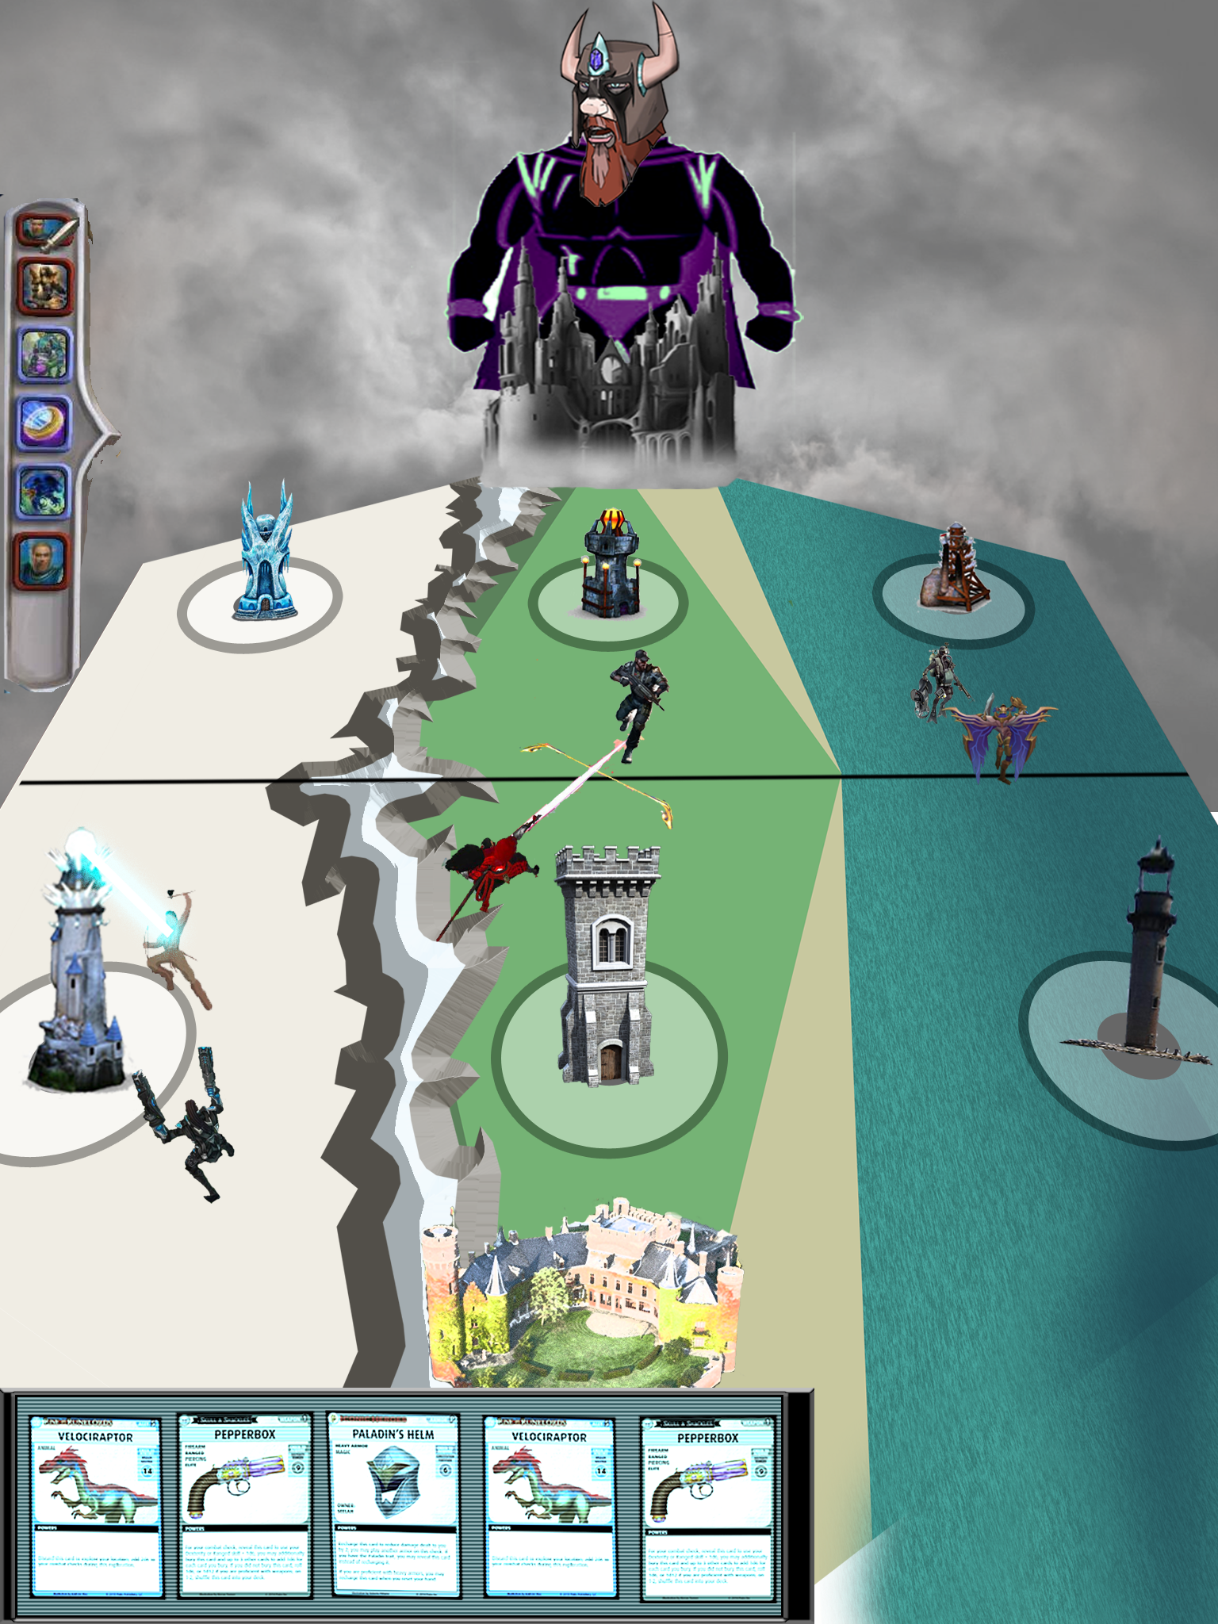
Again, this is the crappy mockup I made
Correct orientation of the screen. HUD elements on top and bottom.
Environment is going to be TINY so no need to make it super detailed.
Low Poly environment because the retro theme and aesthetic calls for it.
The things I’ve outlined in this deck are things I imagine the environment, home bases, and defense towers to look like.

Slide 3
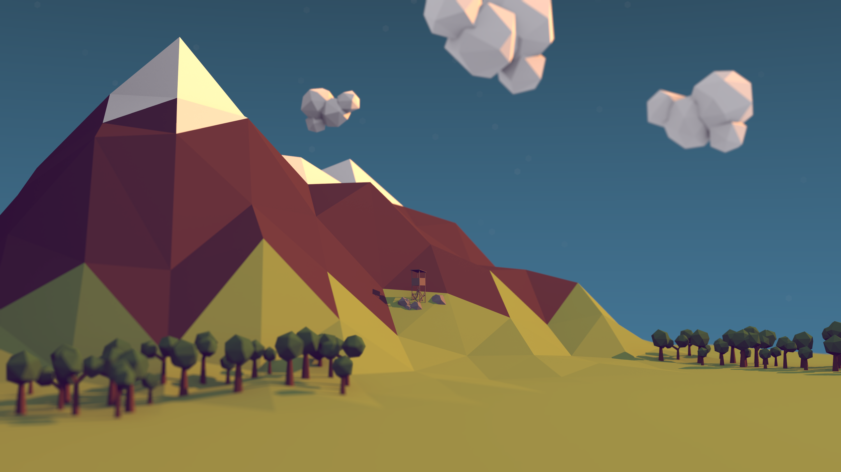
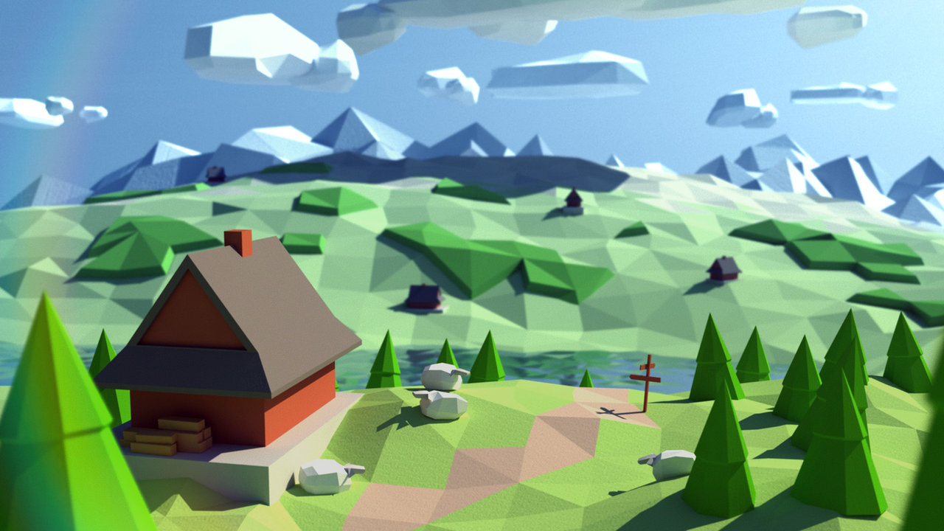
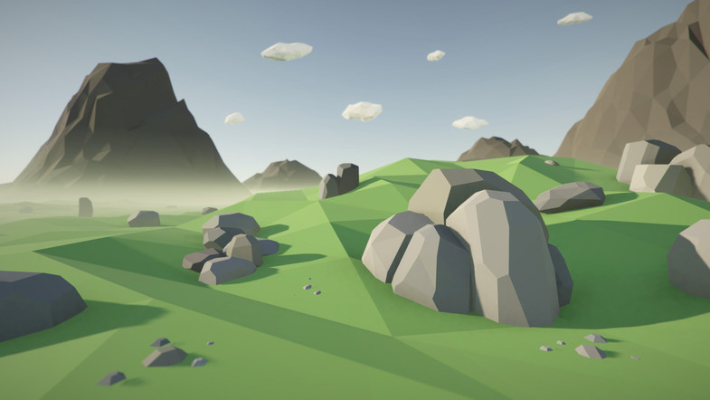
Low Poly Environment
Simple types of mountains
These types of Trees
Rock assets: https://www.assetstore.unity3d.com/en/#!/content/70164 I can buy these for you if you want
These types of Rocks
Other Free Assets:
https://www.assetstore.unity3d.com/en/#!/content/58821
These are free but can also buy you other low-poly assets if you find ones you prefer

Slide 4
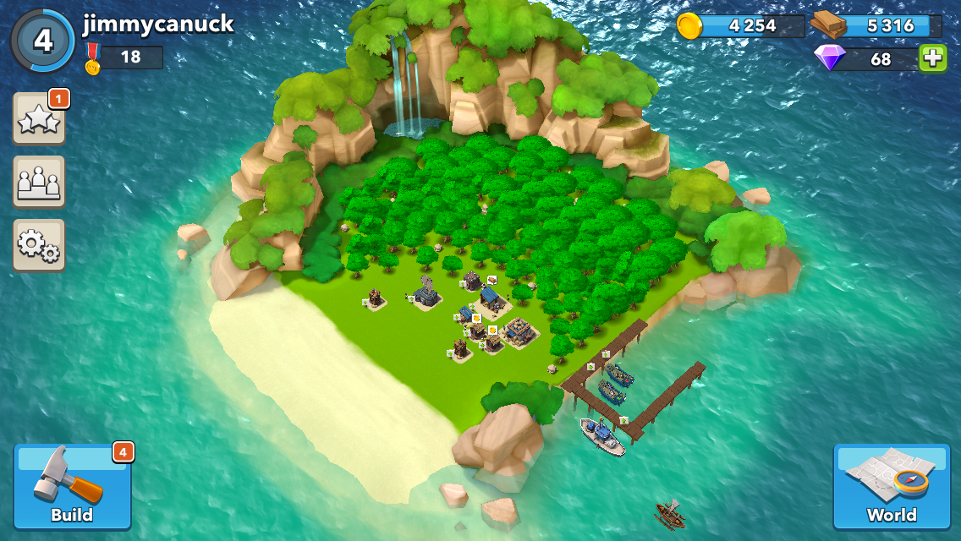
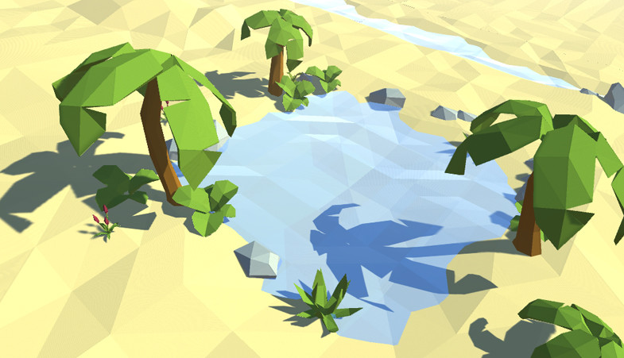
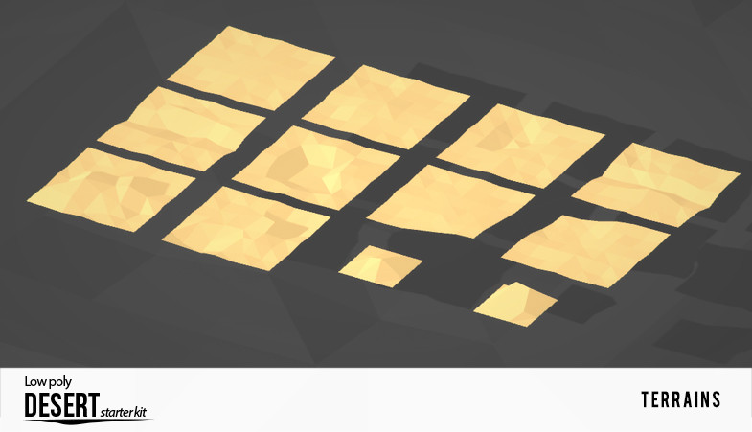
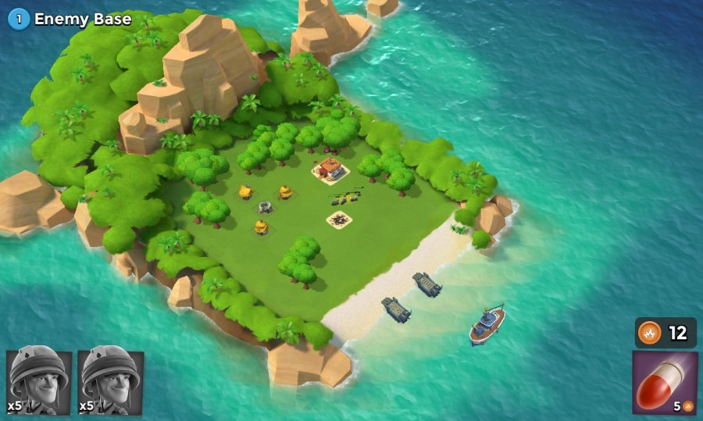
Land to Water
https://www.assetstore.unity3d.com/en/#!/content/64344
I can buy this for you… terrains too.
Layers of transparency going from beach to water
Right & Above: Stills from the mobile game Boom Beach. Note the way they do their beach-to-water transitions. If the splashes are too minutiae then don’t worry about it.
Splashy Splash

Slide 5
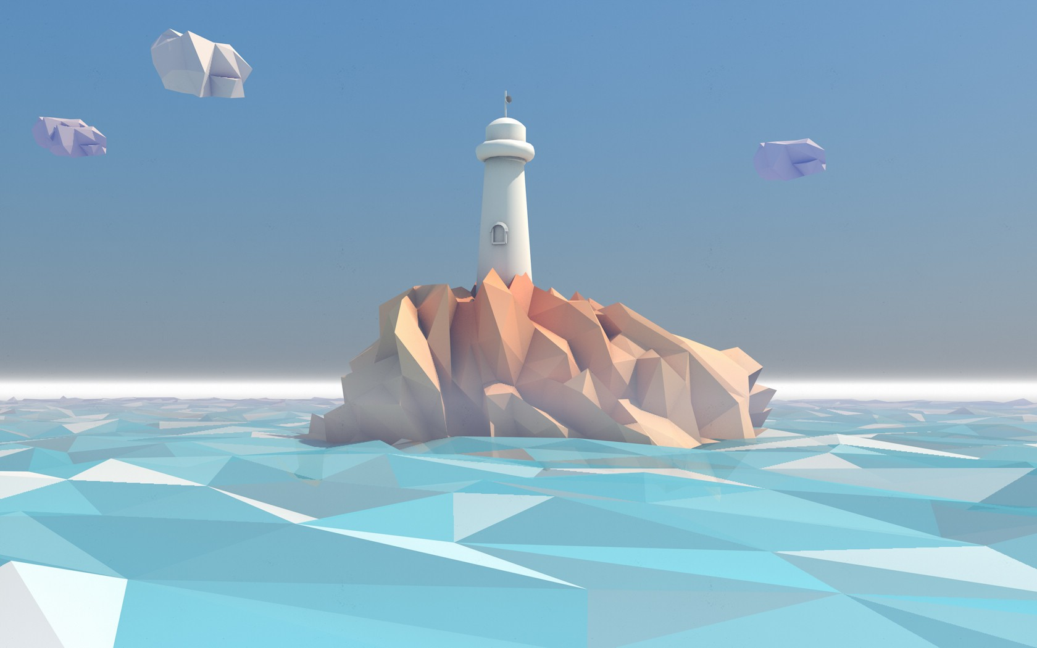
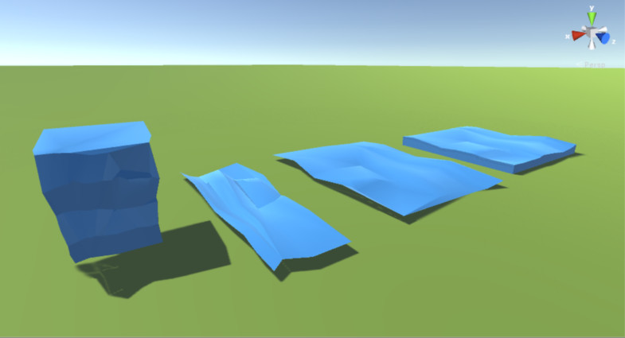
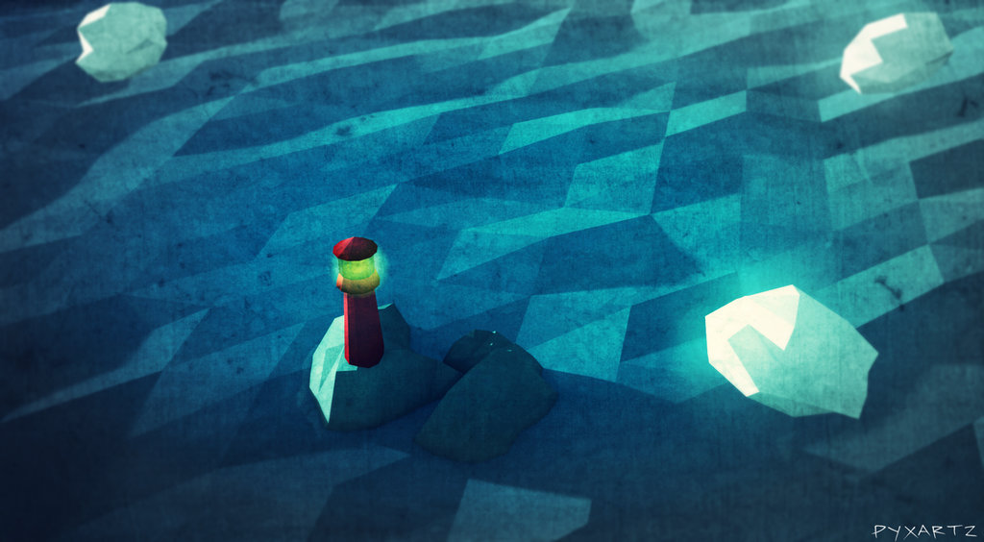
Water Lane & Towers
Doesn’t have to be this complex
The Low Poly water assets below is a part of this pack: https://www.assetstore.unity3d.com/en/#!/content/52666
Water lane – defense towers will jut out of the water on a small island.
Super Simple like this

Slide 6
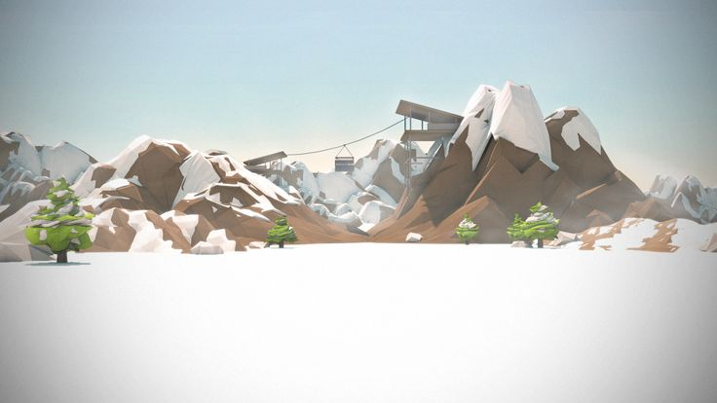
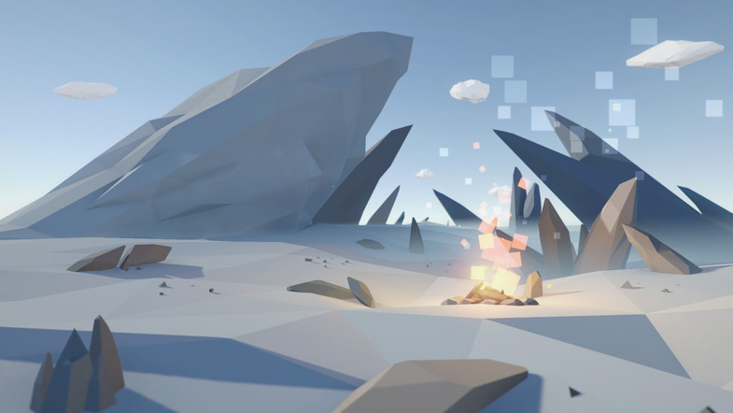
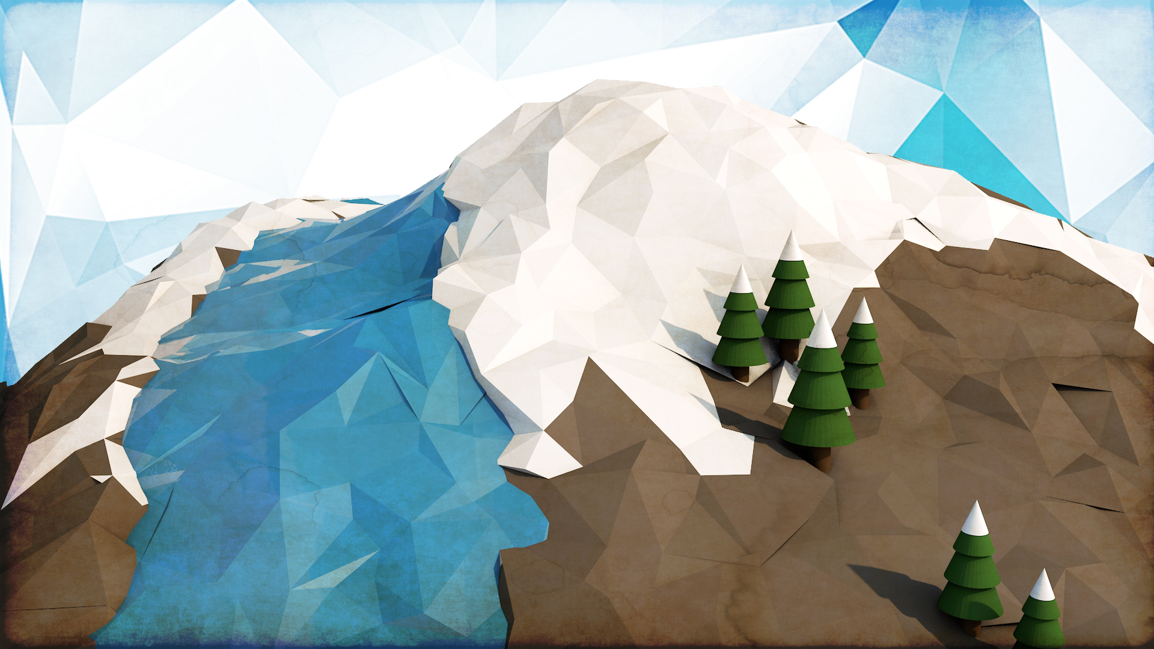
Mountains to Ice Lane
Snow capped peaks
Separating the Land lane & the Ice lane is a small range of mountains. These are not traversable by characters.
The left lane is the Ice lane, with some rocks and glaciers jutting out on either side
Ice assets: https://www.assetstore.unity3d.com/en/#!/content/70164 I can buy these for you if you want
Glaciers jutting out like this along the edges of the lane
Snow capped trees

Slide 7
Bases & Towers

Slide 8
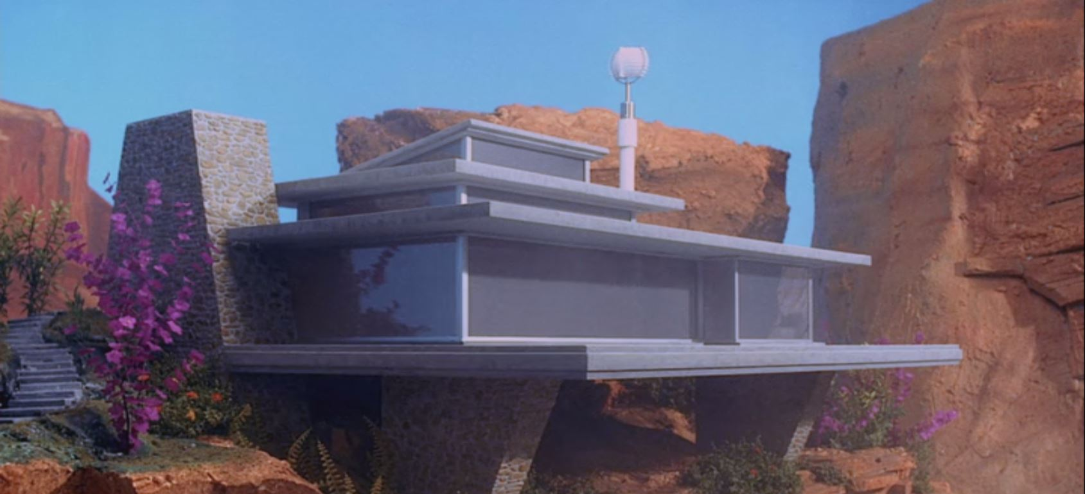
SpyTeam Home Base
Inspired by mid-century modern designs
Simple Flat Roof
Satellite Dish
http://www.turbosquid.com/3d-models/realistic-modern-house-1-3d-model/641398
Satellite
Multi Tier Flat Roofing

Slide 9
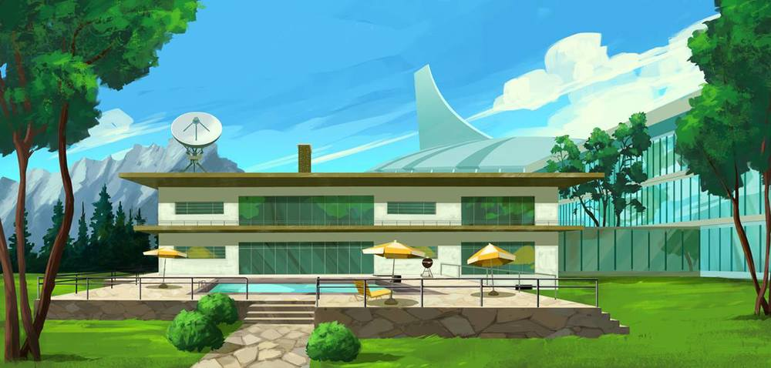
SpyTeam Home Base
Satellite
Le Pool

Slide 10
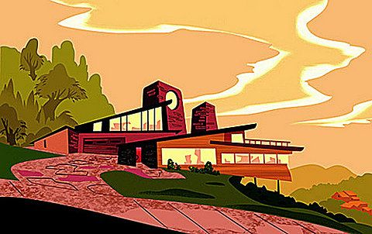
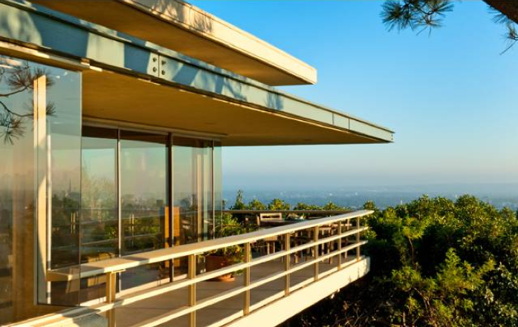
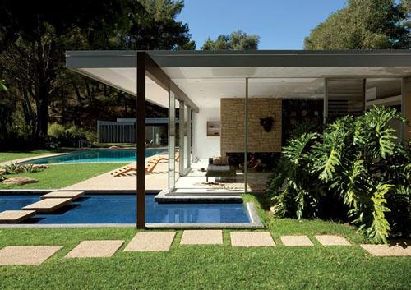
SpyTeam Home Base
Maybe a little angled part
Multi Tier Flat Roofing
Support beam outside the wall

Slide 11
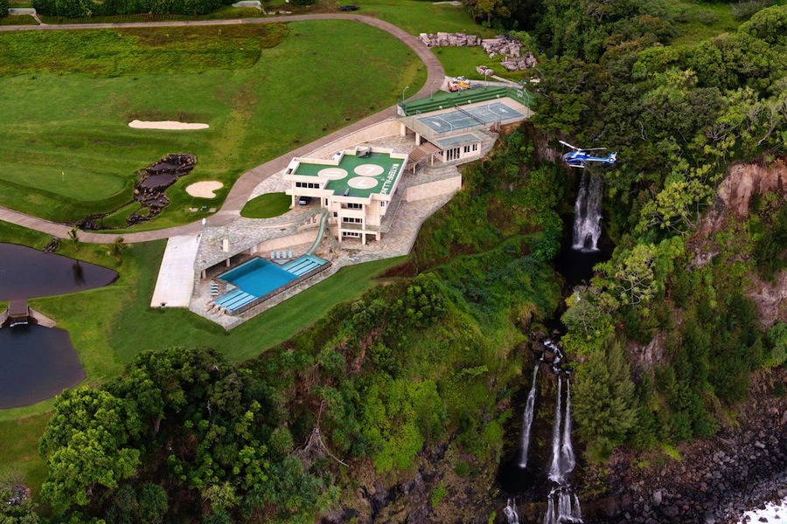
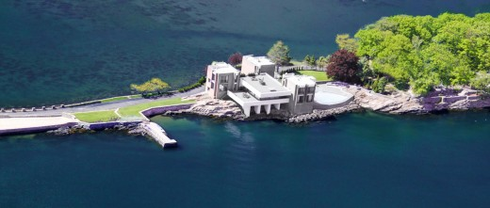
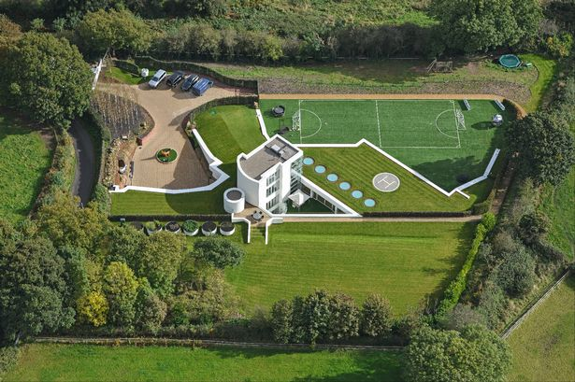
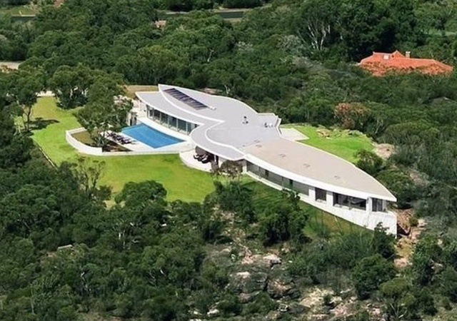
Aerial influences
Viewed from the top down
Helipad
Swimming Pool
Dock
Dock
Chopper Pad
Le Pool

Slide 12
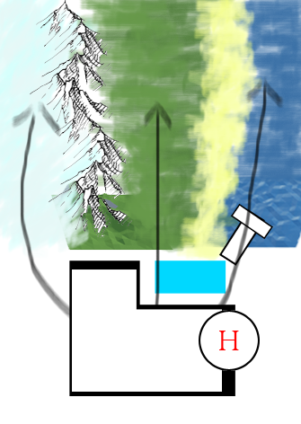
Relation to Map
Each part of the home base has a touchpoint at each lane
The home base is on a larger scale so it can span across all three lanes
Enemy base is equally large

Slide 13
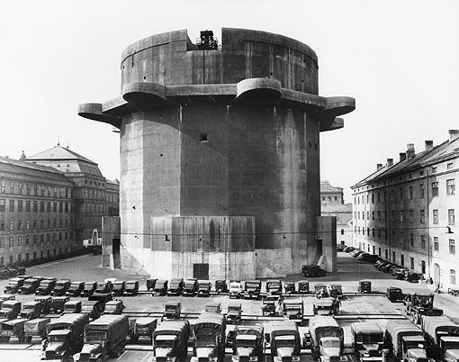
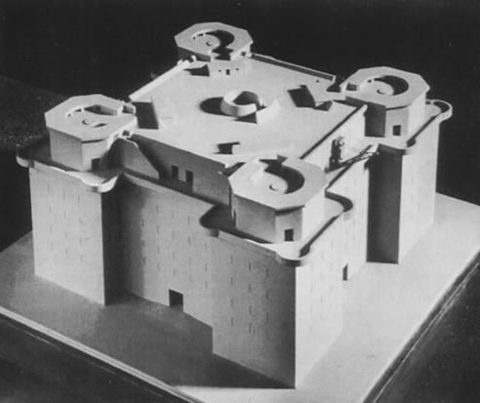
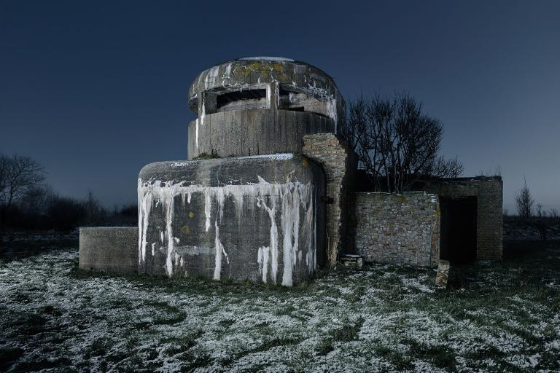
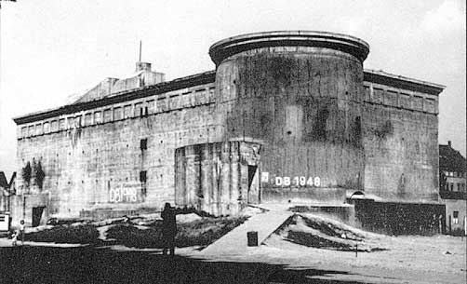
DethCorps Home Base
These little corner Bits
Inspired by German WWII Bunkers
Concrete, looming
Cold & Practical
Small, sparse windows on the walls
Circular Tower Theme
Larger Sniper windows at the top

Slide 14
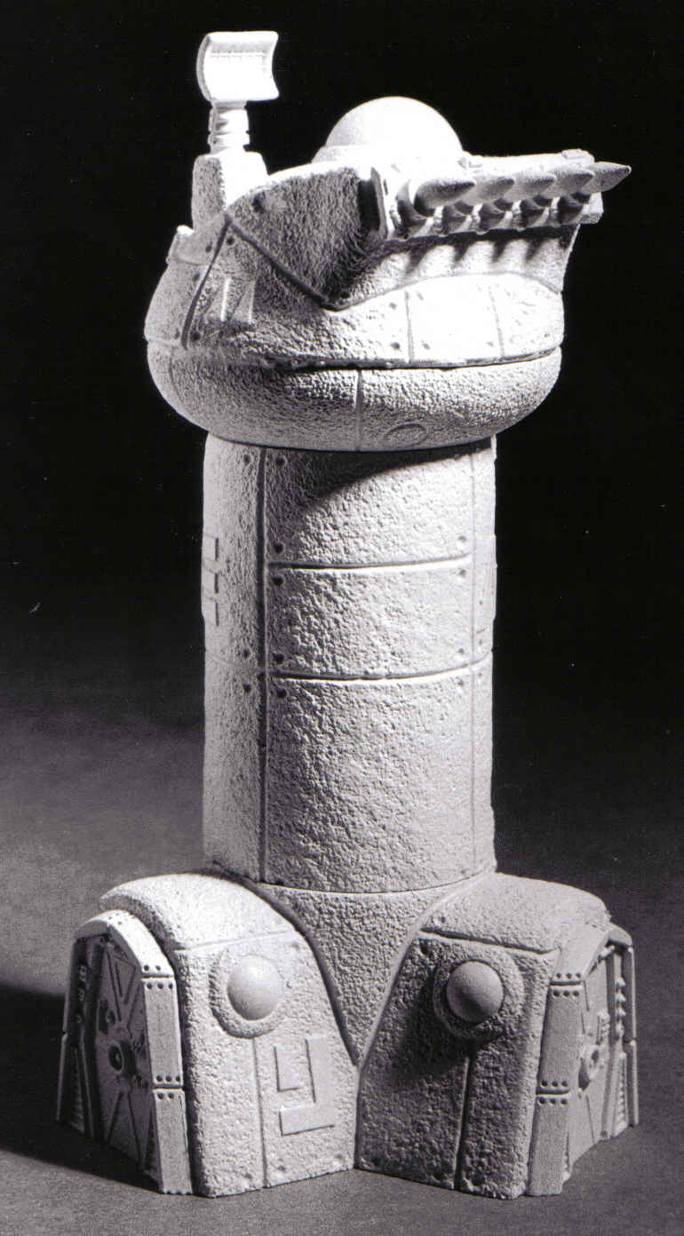
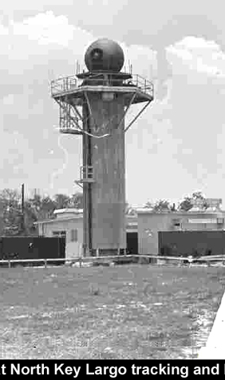
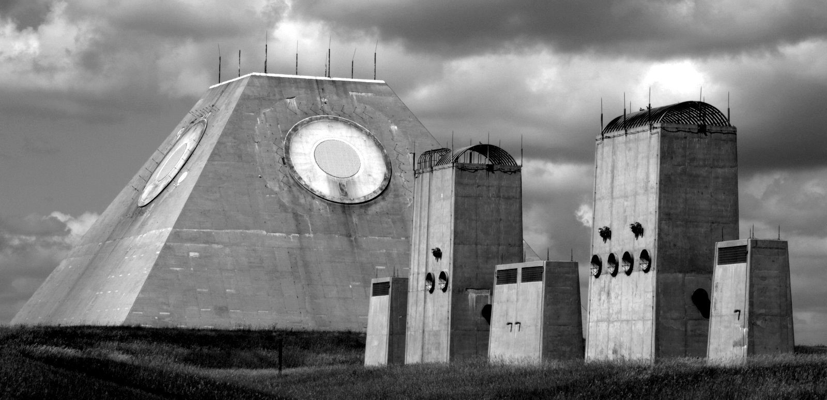
Defense Towers
Globe @ top of tower “EVIL EYE”
You don’t need to make different towers for each lane, one can do for all lanes.
Dunno why I put this here, but it’s a really fucking cool defunct missile defense base in North Dakota
http://www.atlasobscura.com/places/pyramid-north-dakota
These little feet entrances

